Slide 1

DESIGN PATTERNS AND ANTYPATTERNS

Slide 2




WHO WANTS TO BE A MILLIONAIRE?

Slide 3




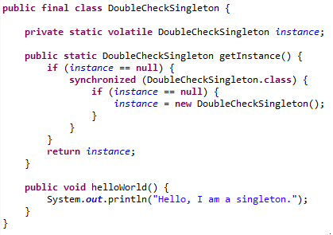
WHY IS THE FOLLOWING IMPLEMENTATION OF THE DOUBLE CHECKED SINGLETON PATTERN INCORRECT?
1/6
Missing private constructor
Singleton cannot be final
It is not a double-checked singleton
Volatile keyword is dangerous

Slide 4
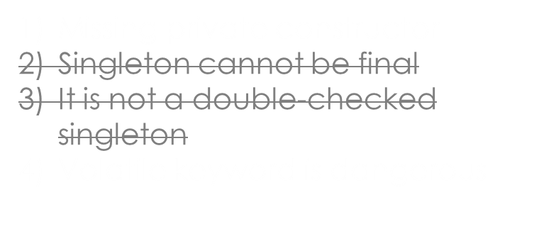

WHY IS THE FOLLOWING IMPLEMENTATION OF THE DOUBLE CHECKED SINGLETON PATTERN INCORRECT?
1/6

Slide 5
WHY IS THE FOLLOWING IMPLEMENTATION OF THE DOUBLE CHECKED SINGLETON PATTERN INCORRECT?
1/6
Missing private constructor
Singleton cannot be final
It is not a double-checked singleton
Volatile keyword is dangerous

Slide 6
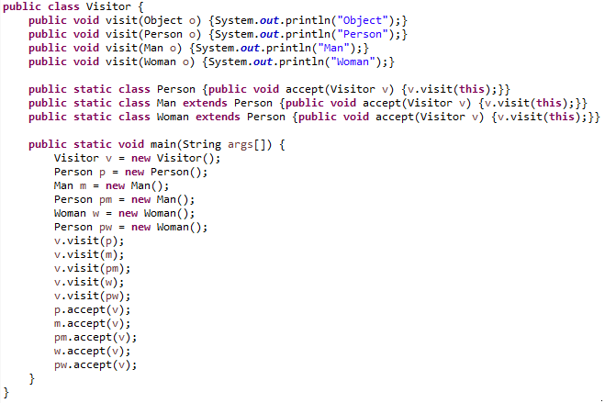
WHAT IS THE OUTPUT OF THE FOLLOWING CODE?
2/6
Output No. 1
Output No. 2
Output No. 3
Output No. 4
Object
Object
Object
Object
Object
Object
Object
Object
Object
Object
Person
Man
Person
Woman
Person
Person
Man
Man
Woman
Woman
Person
Man
Man
Woman
Woman
Person
Man
Man
Woman
Woman
Person
Man
Man
Woman
Woman
Person
Man
Person
Woman
Person
1 2 3 4

Slide 7
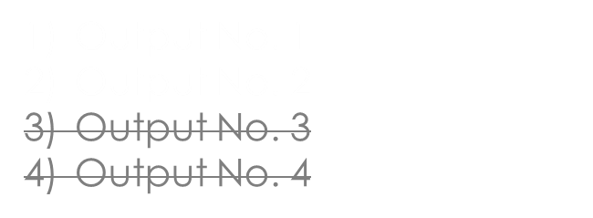

WHAT IS THE OUTPUT OF THE FOLLOWING CODE?
2/6
Object
Object
Object
Object
Object
Object
Object
Object
Object
Object
Person
Man
Person
Woman
Person
Person
Man
Man
Woman
Woman
Person
Man
Man
Woman
Woman
Person
Man
Man
Woman
Woman
Person
Man
Man
Woman
Woman
Person
Man
Person
Woman
Person
1 2 3 4

Slide 8
WHAT IS THE OUTPUT OF THE FOLLOWING CODE?
2/6
Output No. 1
Output No. 2
Output No. 3
Output No. 4
Object
Object
Object
Object
Object
Object
Object
Object
Object
Object
Person
Man
Person
Woman
Person
Person
Man
Man
Woman
Woman
Person
Man
Man
Woman
Woman
Person
Man
Man
Woman
Woman
Person
Man
Man
Woman
Woman
Person
Man
Person
Woman
Person
1 2 3 4

Slide 9
SELECT ONE INVALID STATEMENT ABOUT THE COMPOSITE DESIGN PATTERN
3/6
Composite design pattern is a functional pattern.
Implementing the composite pattern lets clients treat individual objects and compositions uniformly.
The child-manipulation methods are in the main Component interface, not just the Composite subclass or only in leafs.
The composite pattern is part of the classic Gang of Four structural pattern group.

Slide 10
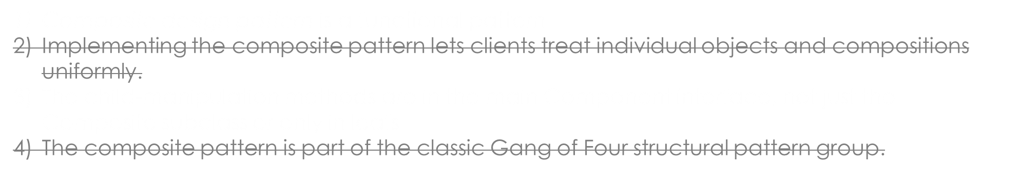

SELECT ONE INVALID STATEMENT ABOUT THE COMPOSITE DESIGN PATTERN
3/6

Slide 11
SELECT ONE INVALID STATEMENT ABOUT THE COMPOSITE DESIGN PATTERN
3/6
Composite design pattern is a functional pattern.
Implementing the composite pattern lets clients treat individual objects and compositions uniformly.
The child-manipulation methods are in the main Component interface, not just the Composite subclass or only in leafs.
The composite pattern is part of the classic Gang of Four structural pattern group.

Slide 12
HOW DO WE ACCOMPLISH DOUBLE-DISPATCH IN STANDARD OO LANGUAGES, SUCH AS JAVA?
4/6
Inheritance and encapsulation
Inheritance and polymorphism
Polymorphism and method overloading
Composition and polymorphism

Slide 13
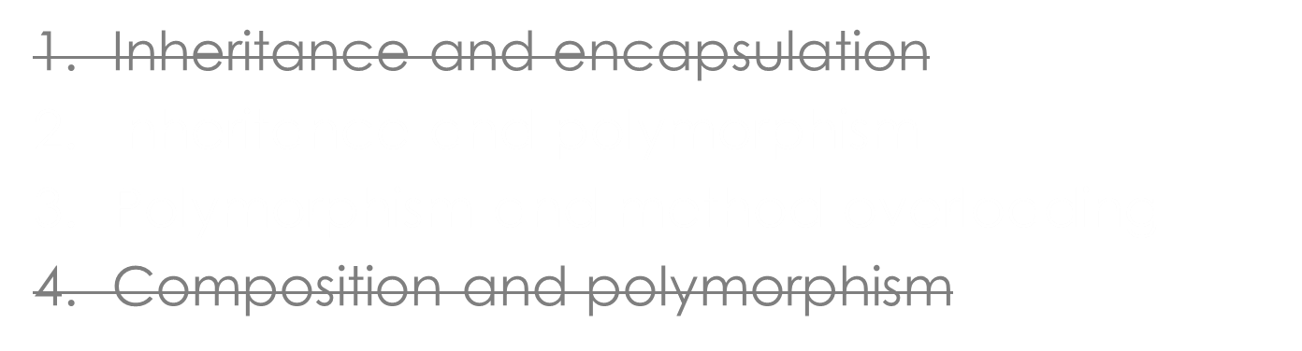

HOW DO WE ACCOMPLISH DOUBLE-DISPATCH IN STANDARD OO LANGUAGES, SUCH AS JAVA?
4/6

Slide 14
HOW DO WE ACCOMPLISH DOUBLE-DISPATCH IN STANDARD OO LANGUAGES, SUCH AS JAVA?
4/6
Inheritance and encapsulation
Inheritance and polymorphism
Polymorphism and method overloading
Composition and polymorphism

Slide 15
WHICH OF THE FOLLOWING IS CHALLENGING IN VISITOR PATTERN?
5/6
Adding new functionality by implementing new Visitor
Adding new concrete Element
Combine Visitor pattern with Composite pattern
Adding the accept method to Element interface when you are owner of the code base where Element and Visitor belongs to

Slide 16
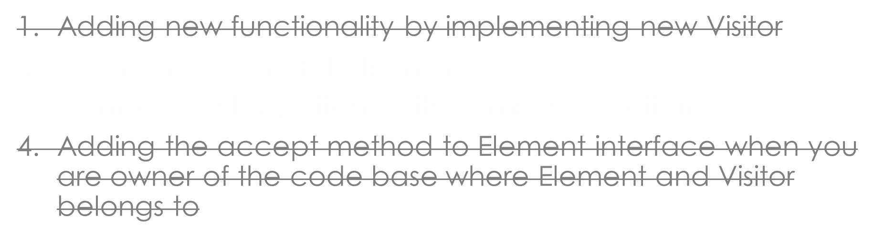
WHICH OF THE FOLLOWING IS CHALLENGING IN VISITOR PATTERN?
5/6

Slide 17
WHICH OF THE FOLLOWING IS CHALLENGING IN VISITOR PATTERN?
5/6
Adding new functionality by implementing new Visitor
Adding new concrete Element
Combine Visitor pattern with Composite pattern
Adding the accept method to Element interface when you are owner of the code base where Element and Visitor belongs to

Slide 18
WHICH OF THE FOLLOWING IS NOT A GOOD USAGE OF VISITOR DESIGN PATTERN? (SELECT 1 OPTION)
6/6
Adding a functionality to a hierarchy elements (nodes) when it comes from a library that we can't change
An algorithm involves several classes of the object structure, but it is desired to manage it in one single location
The new operation doesn't logically belong to the Element's functionality, responsibility or API, for example serialization of the hierarchy of Employees to various formats such as XML or JSON
Implement different look-and-feels, define different appearances and behavior for user interface “widgets”

Slide 19
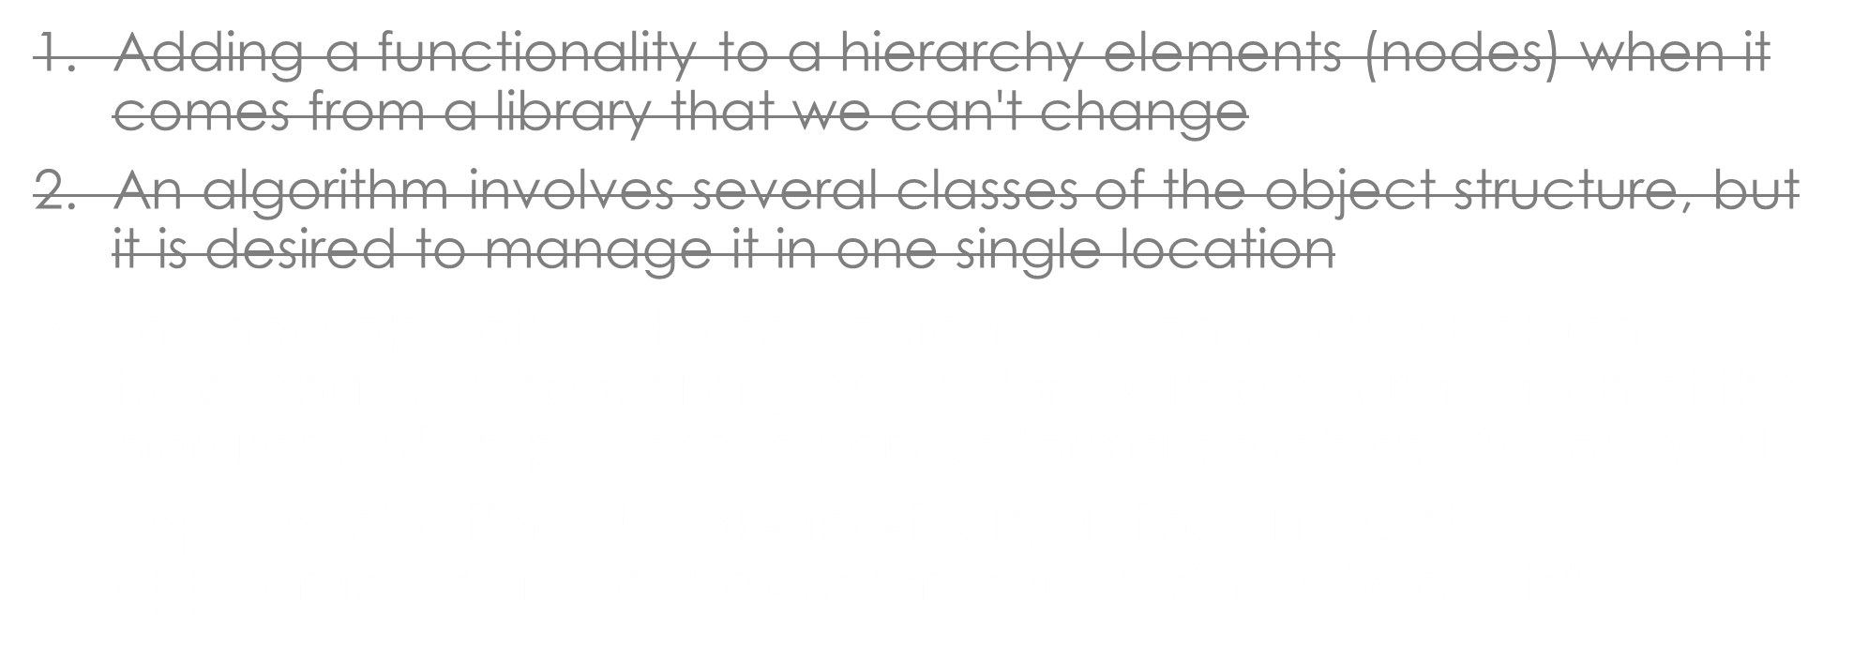
WHICH OF THE FOLLOWING IS NOT A GOOD USAGE OF VISITOR DESIGN PATTERN? (SELECT 1 OPTION)
6/6

Slide 20
WHICH OF THE FOLLOWING IS NOT A GOOD USAGE OF VISITOR DESIGN PATTERN? (SELECT 1 OPTION)
6/6
Adding a functionality to a hierarchy elements (nodes) when it comes from a library that we can't change
An algorithm involves several classes of the object structure, but it is desired to manage it in one single location
The new operation doesn't logically belong to the Element's functionality, responsibility or API, for example serialization of the hierarchy of Employees to various formats such as XML or JSON
Implement different look-and-feels, define different appearances and behavior for user interface “widgets”

